Slide 1

Safety in the Aviation Industry
A look at airline safety considering recent incidents

Slide 2
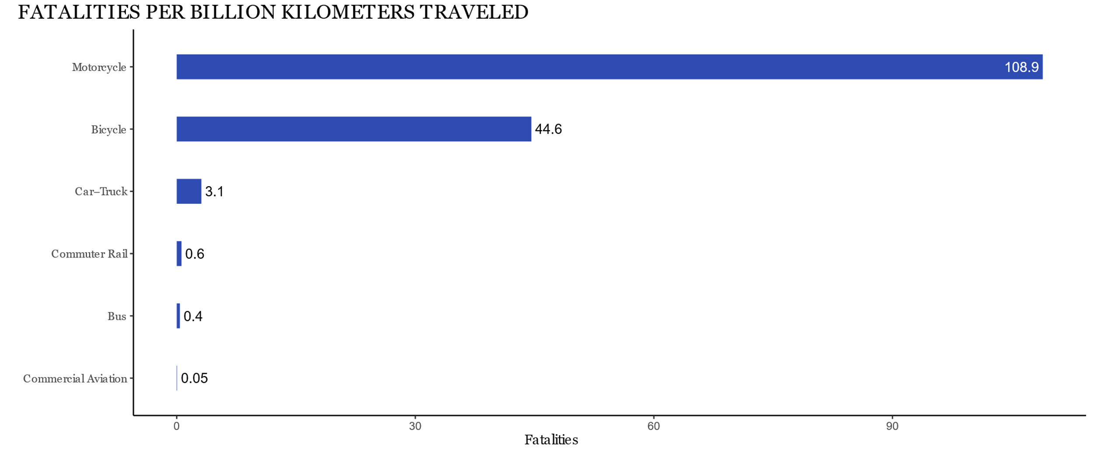
Fatalities by Mode of Transport

Slide 3
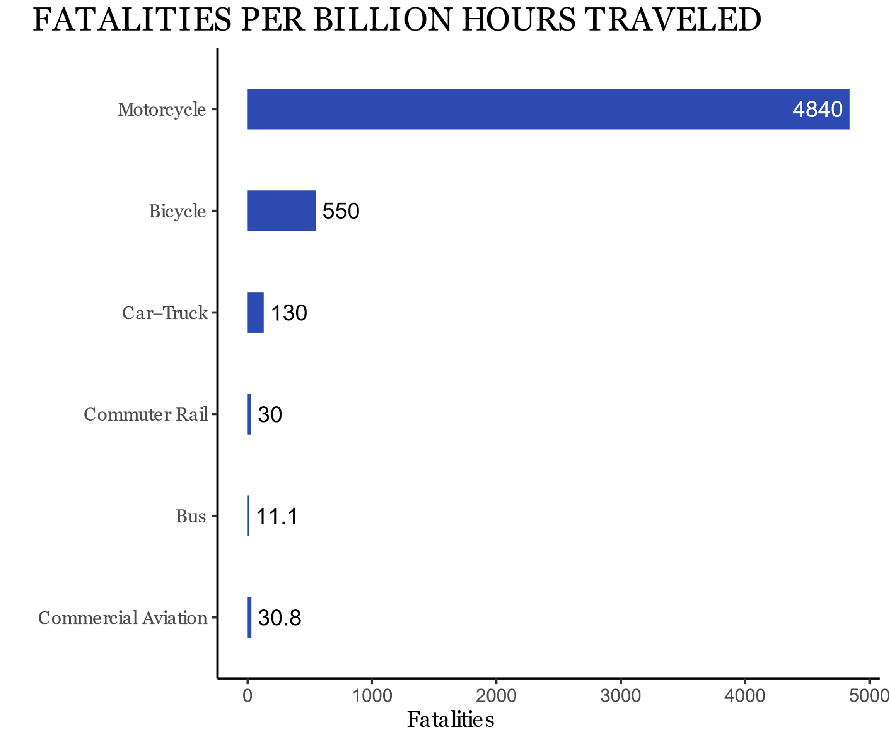
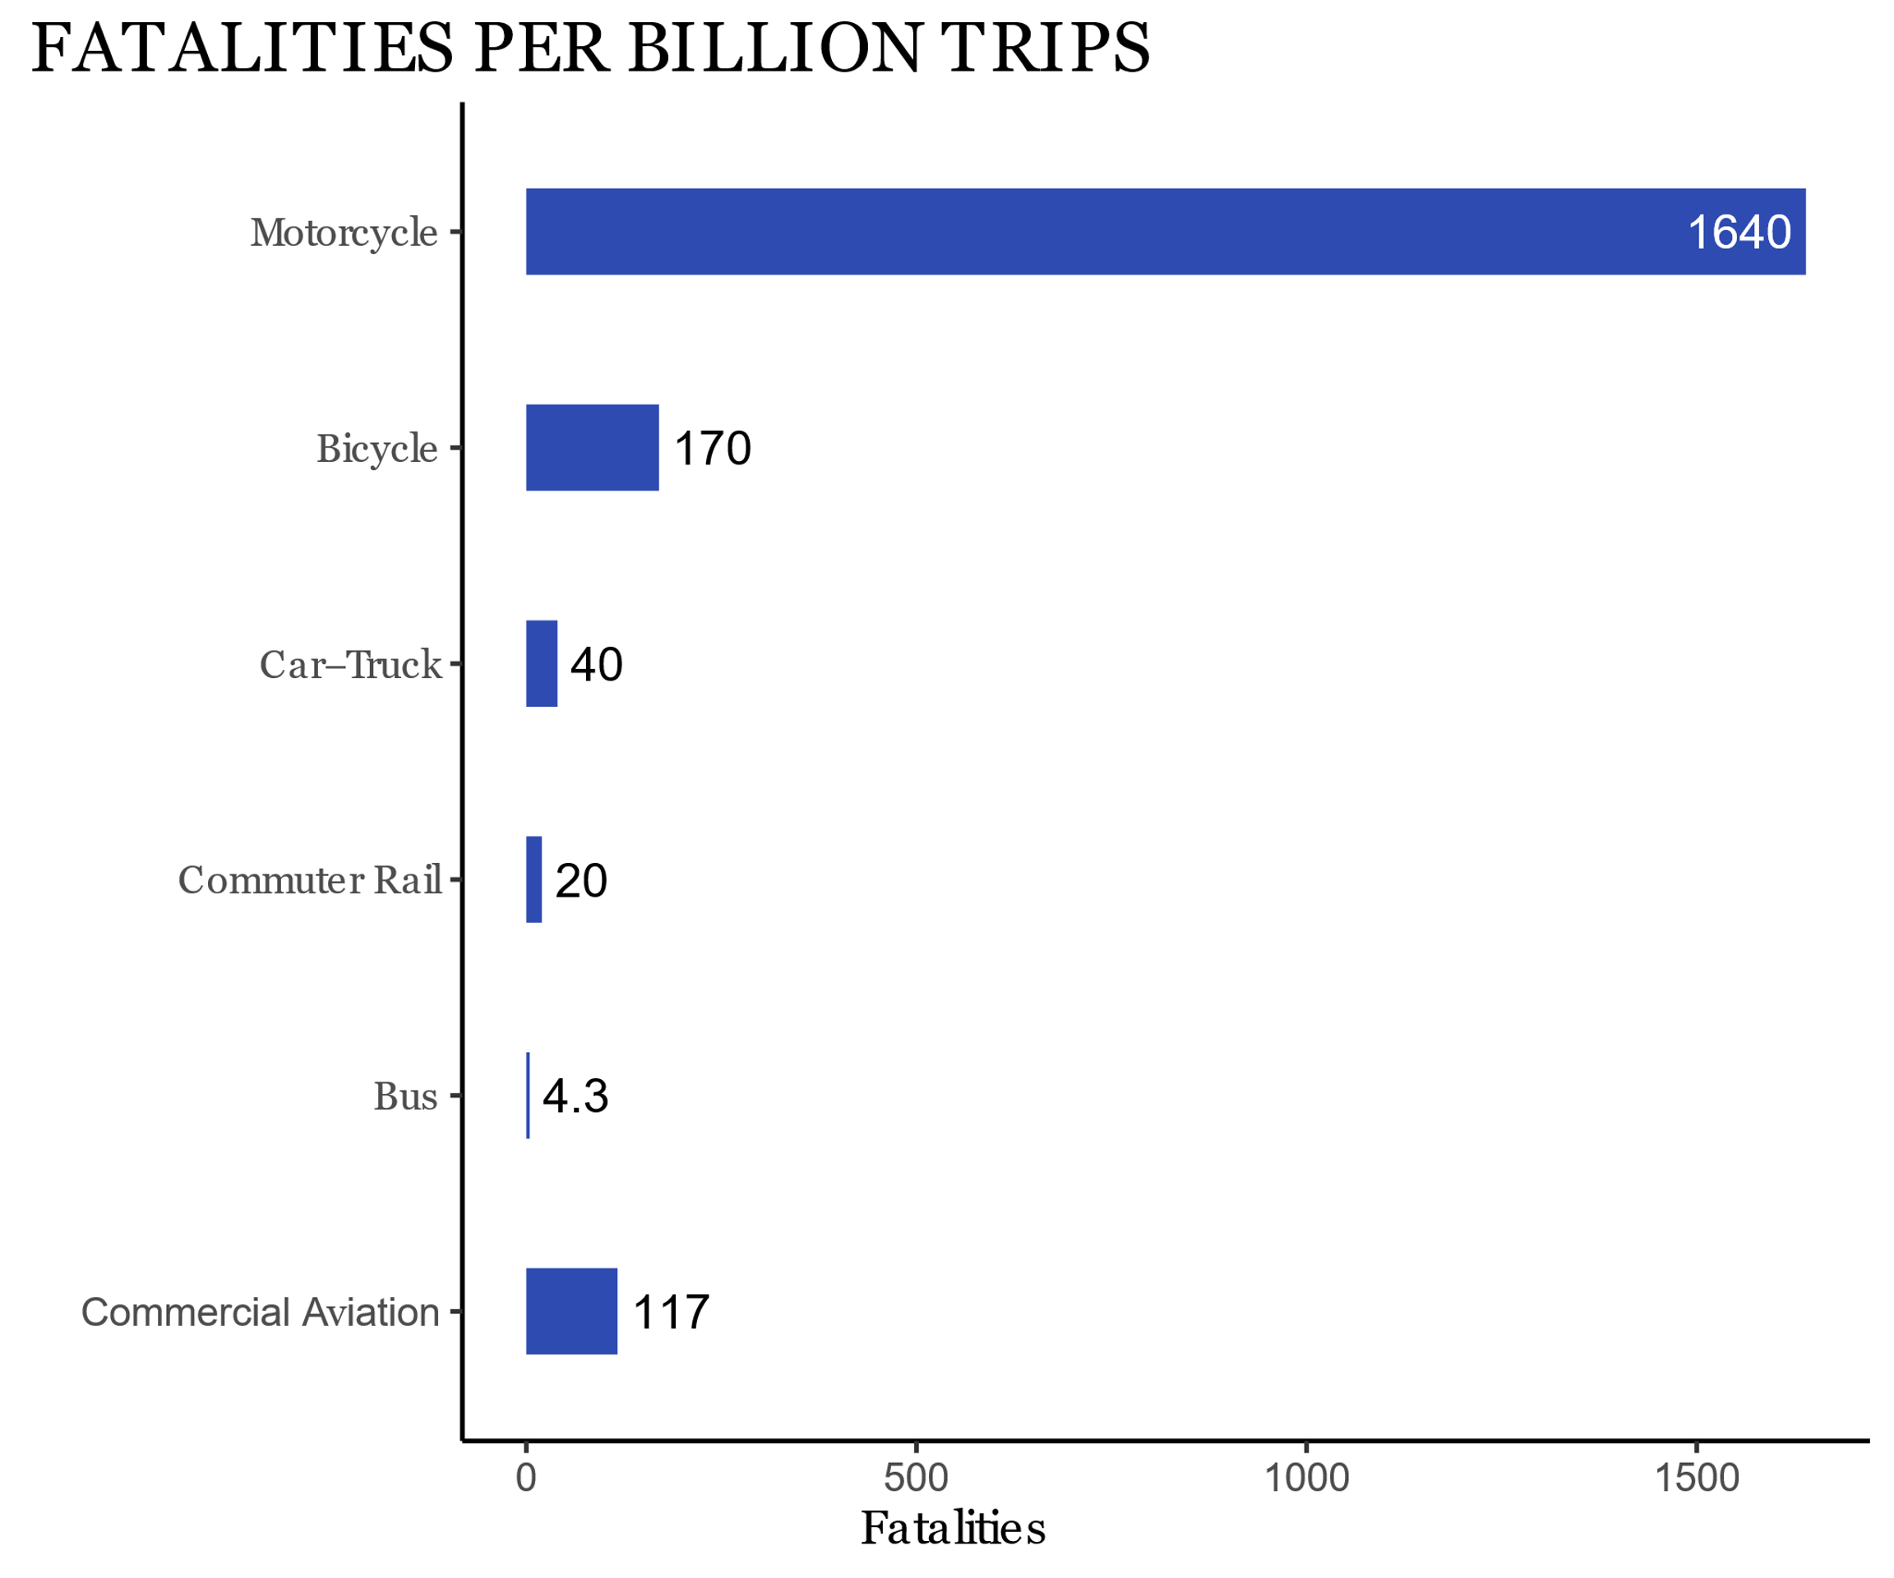
Fatalities by Mode of Transport (cont.)

Slide 4
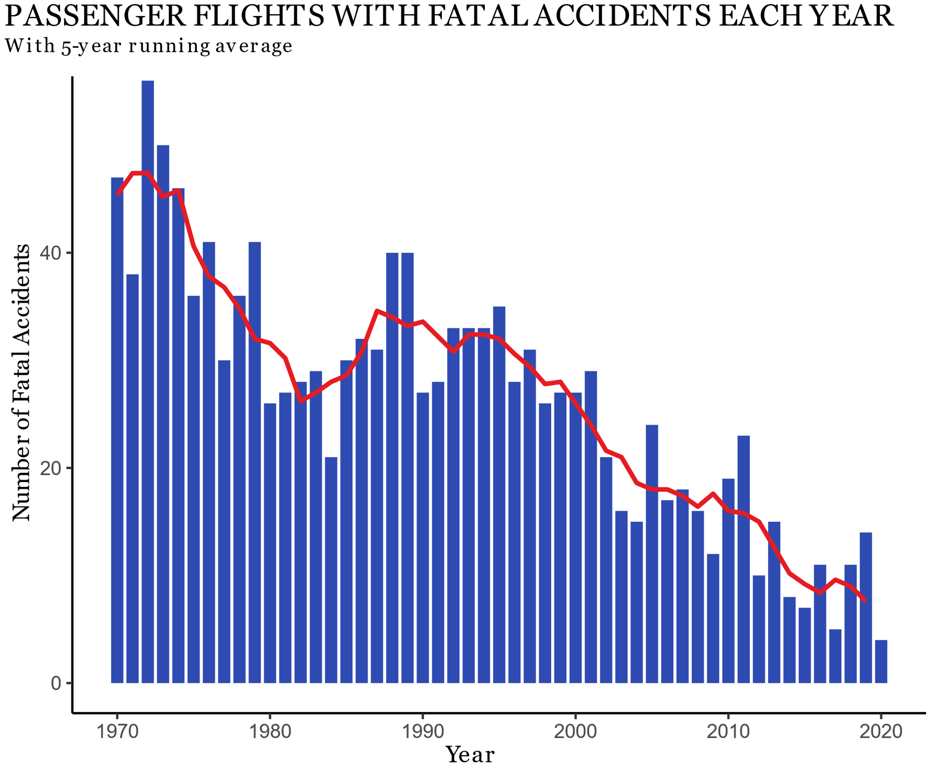
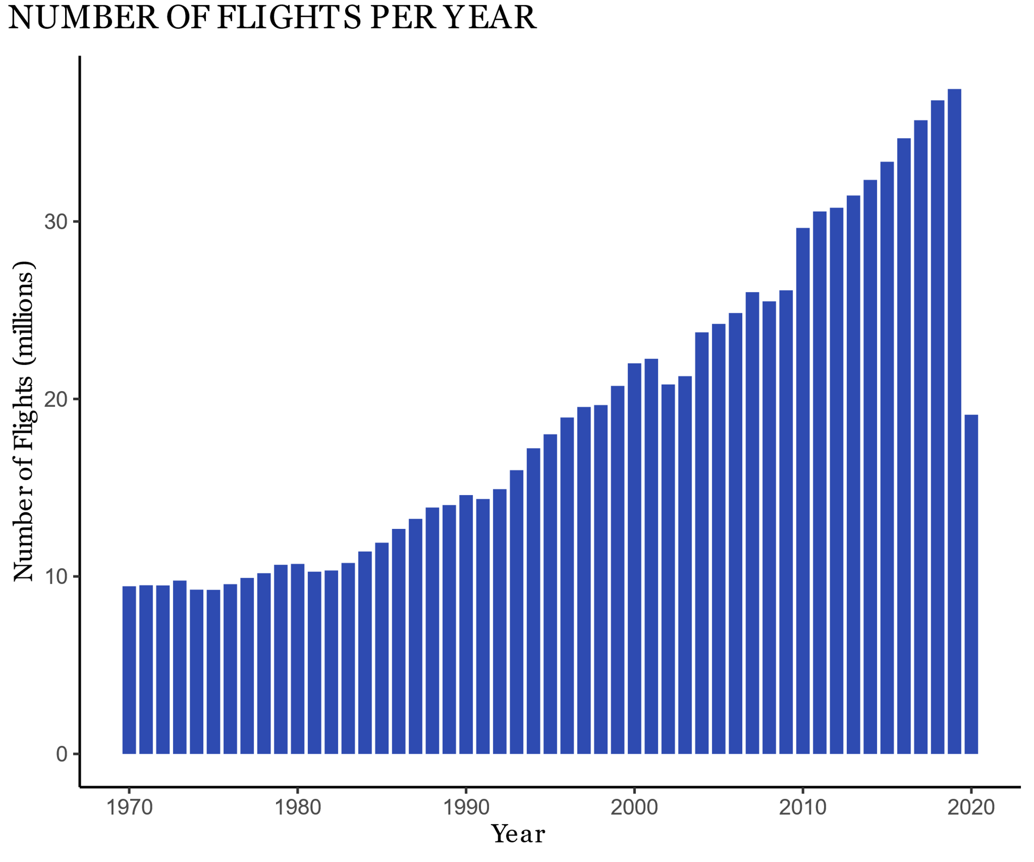
Decreasing Accidents + Increasing Flights

Slide 5
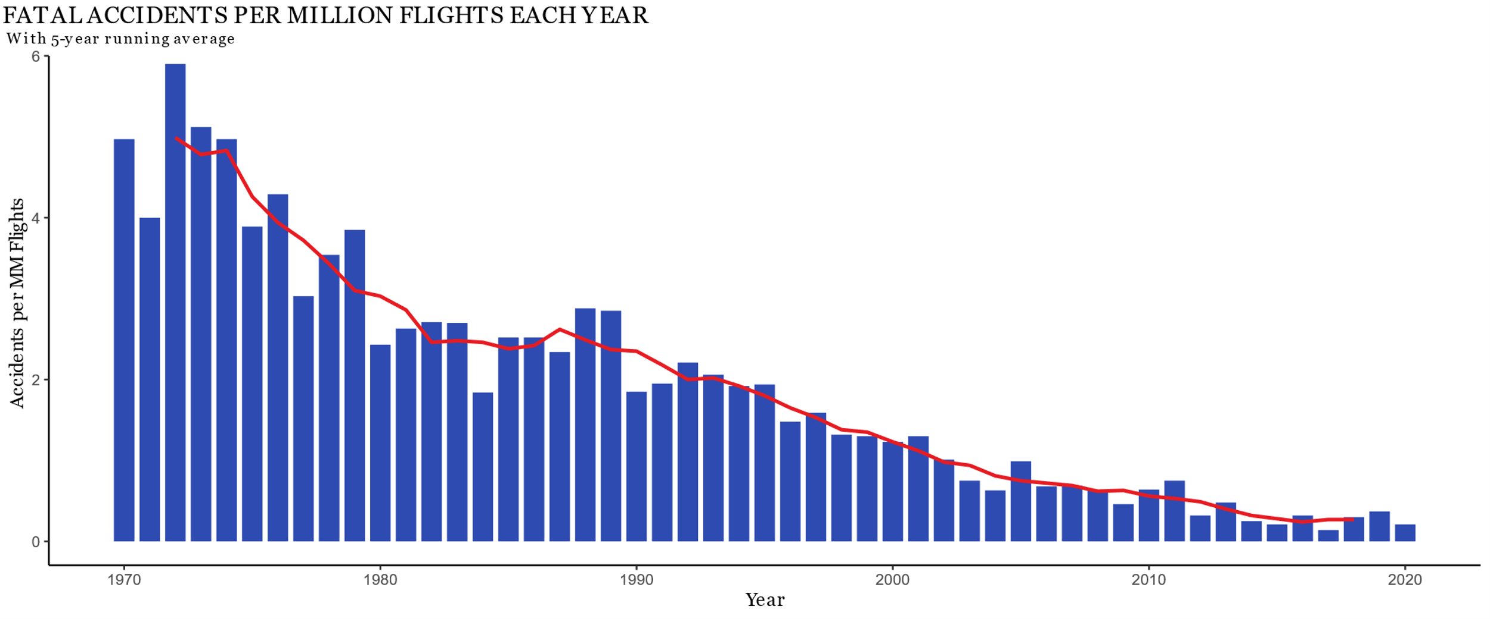
= Lower Risk per Flight

Slide 6
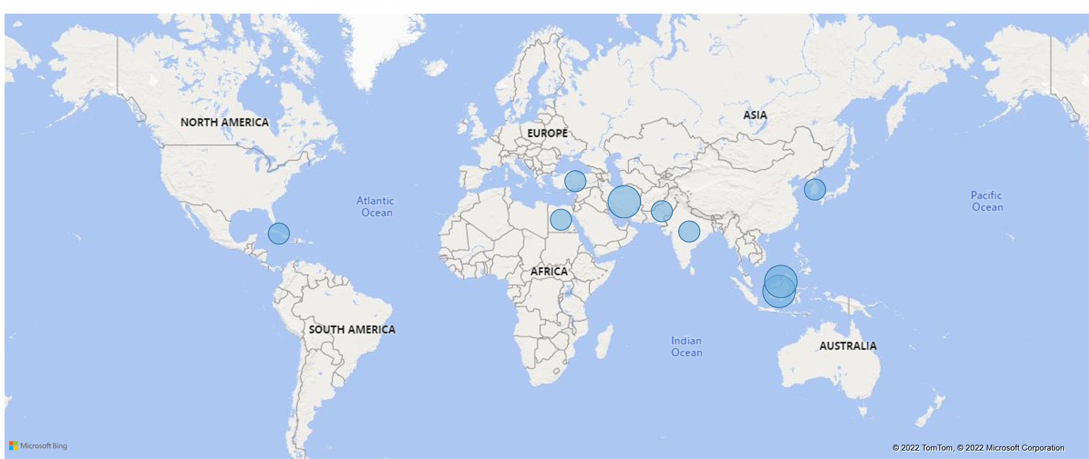
Accidents with ≥19 Passengers: last 10 years

Slide 7
Southwest Airlines
Great track record:
ZERO passenger deaths from aviation accidents

Slide 8
Sources
https://www.bus.com/blog/safest-mode-of-transportation/
http://www.numberwatch.co.uk/risks_of_travel.htm
https://aviation-safety.net/
http://www.planecrashinfo.com/accidents.htm
http://www.airsafe.com/ten_faq.htm

Slide 9
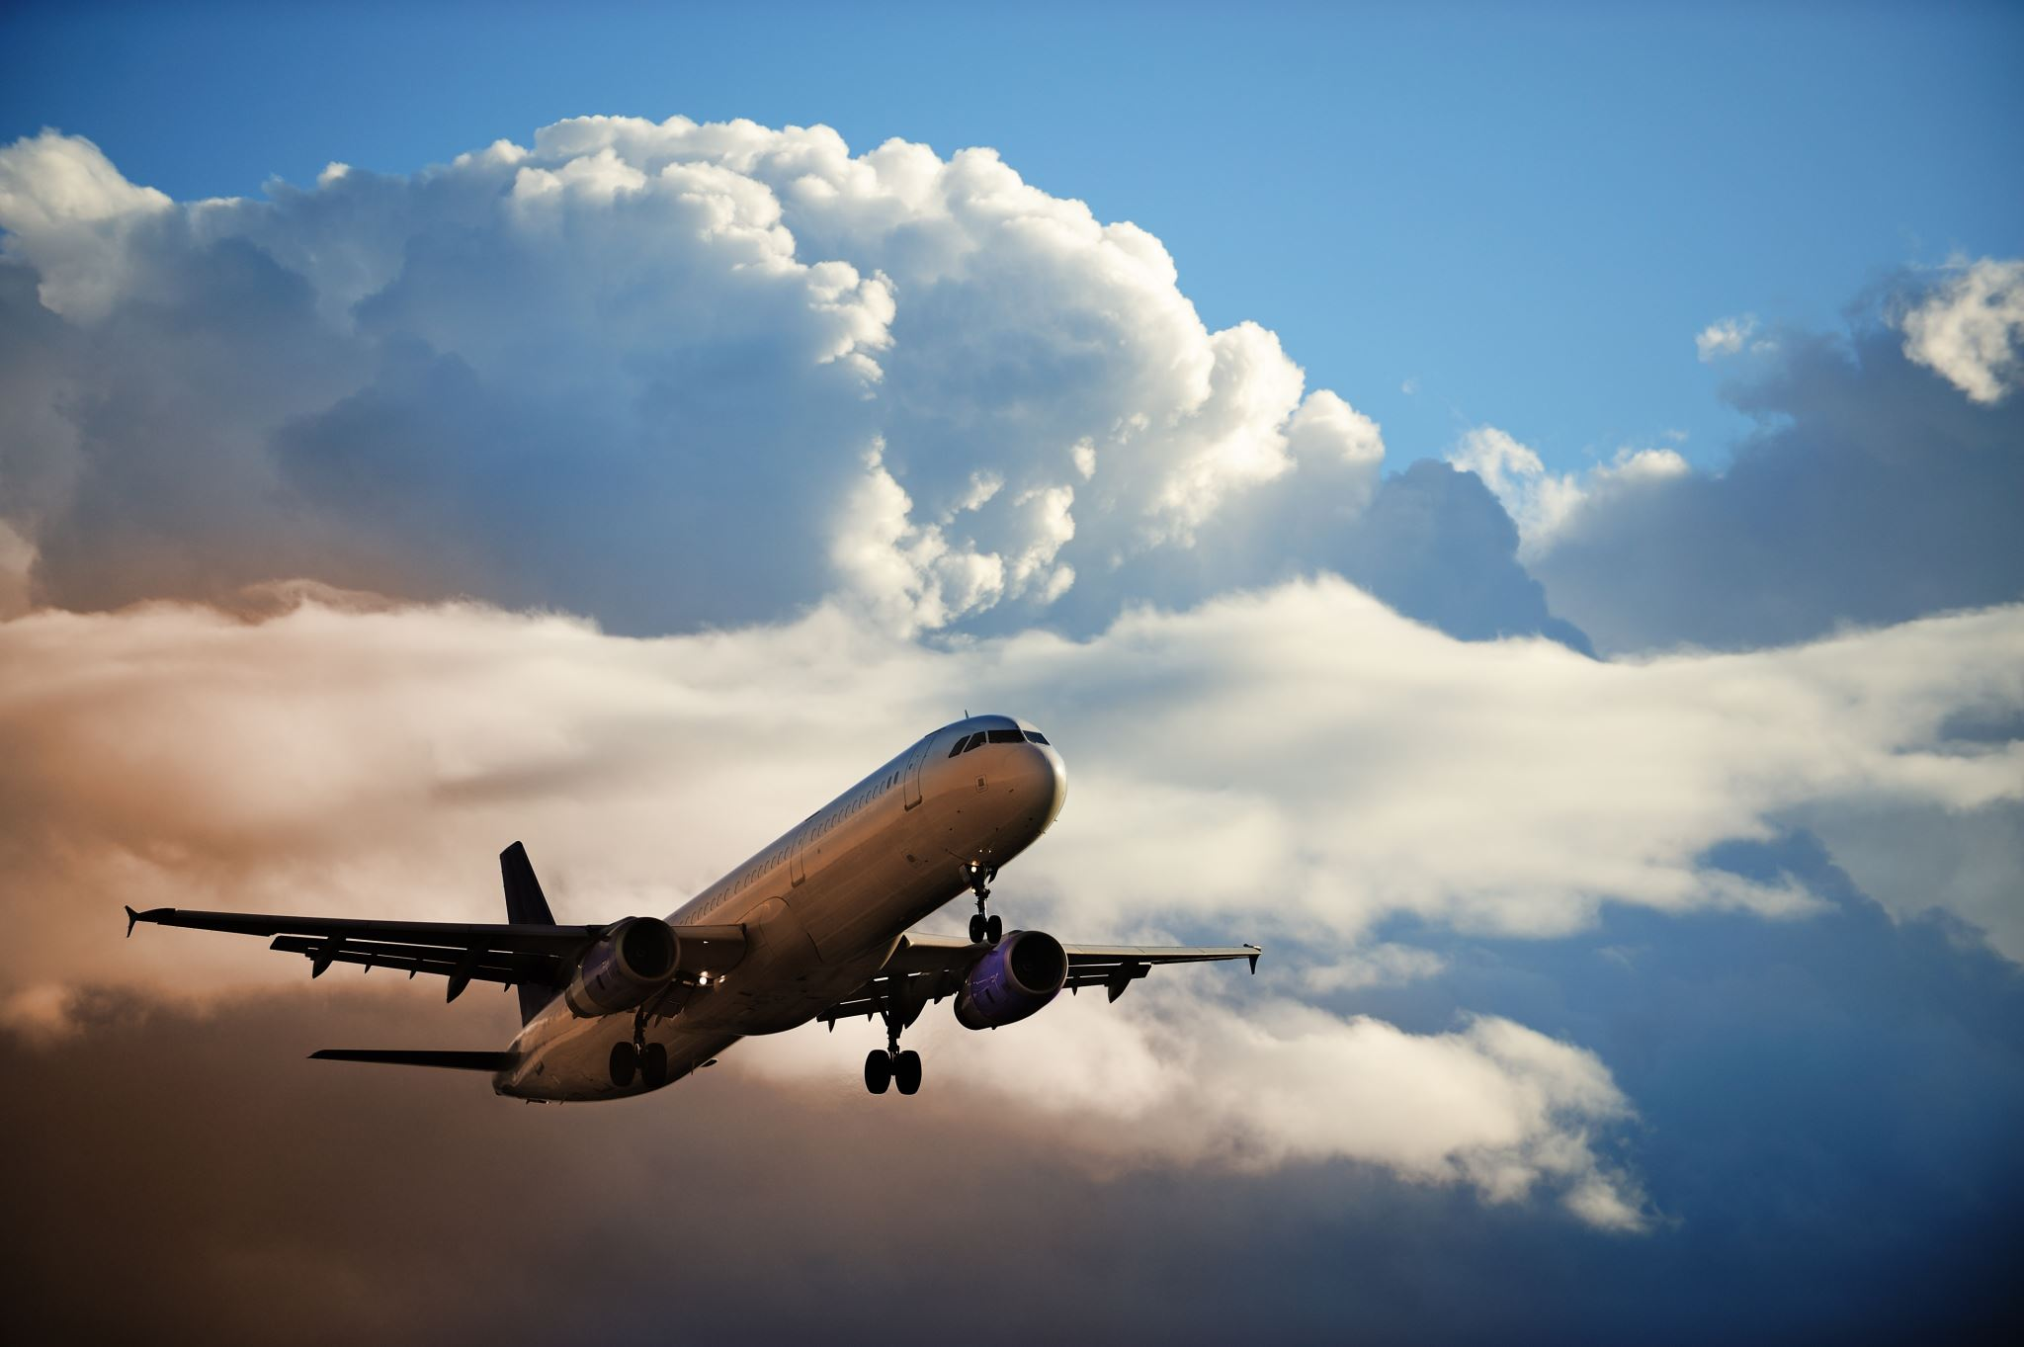
Safe Travels!

